Slide 1
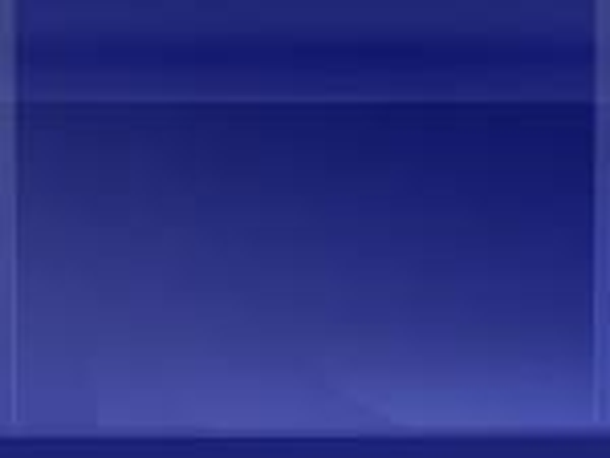
我知誰掌管明天
I know who holds tomorrow

Slide 2
我不知明天的道路
每一天只為主活
I don’t know about tomorrow
I just live from day to day
I know Who holds tomorrow 1/3

Slide 3
我不借明天的太陽
因明天也許陰暗
And I don't borrow from the sunshine For its skies might turn to grey

Slide 4
我不要為將來憂慮
因我信主的應許
And I don‘t worry about the future For I know what Jesus said

Slide 5
我今天要與主同行
因祂知前面如何
And today I'm gonna walk right beside him For He knows what is ahead

Slide 6
有許多未來的事情 我現在不能識透
There are many things about tomorrow I don't seem to understand
Refrain

Slide 7
但我知誰掌管明天 我也知誰牽我手
But I know who holds tomorrow And I know who holds my hand

Slide 8
每一步越走越光明
像攀登黃金階梯
Every step is getting brighter As the golden stairs I climb
I know Who holds tomorrow 2/3

Slide 9
每重擔越挑越輕省
每朵雲披上銀衣
Every burden is getting lighter Every cloud is silver lined

Slide 10
在那裏陽光常普照
在那裏沒有眼淚
There the sun is always shining There no tear will dim the eye

Slide 11
在美麗彩虹的盡頭
眾山嶺與天相連
At the ending of the rainbow Where the mountains, they touch the sky

Slide 12
有許多未來的事情 我現在不能識透
There are many things about tomorrow I don't seem to understand
Refrain

Slide 13
但我知誰掌管明天 我也知誰牽我手
But I know who holds tomorrow And I know who holds my hand

Slide 14
我不知明天将如何
或遭遇生活苦楚
I don’t Know about tomorrow
It may bring me poverty
I know Who holds tomorrow 3/3

Slide 15
但那位養活麻雀者
他必然也看顧我
But the one who feeds the sparrow Is the one who stands by me

Slide 16
他是我旅途的良伴
或經過水火之災
And the path that is my portion
May be through the flame or flood

Slide 17
但救主必與我同在
祂寶血把我遮蓋
But His presence goes before me
And I’m covered with His Blood

Slide 18
有許多未來的事情 我現在不能識透
There are many things about tomorrow I don't seem to understand
Refrain

Slide 19
但我知誰掌管明天 我也知誰牽我手
But I know who holds tomorrow And I know who holds my hand

Slide 20
有許多未來的事情 我現在不能識透
There are many things about tomorrow I don't seem to understand
Refrain

Slide 21
但我知誰掌管明天 我也知誰牽我手
But I know who holds tomorrow And I know who holds my hand
END

